Slide 1
Image Caption

Slide 2
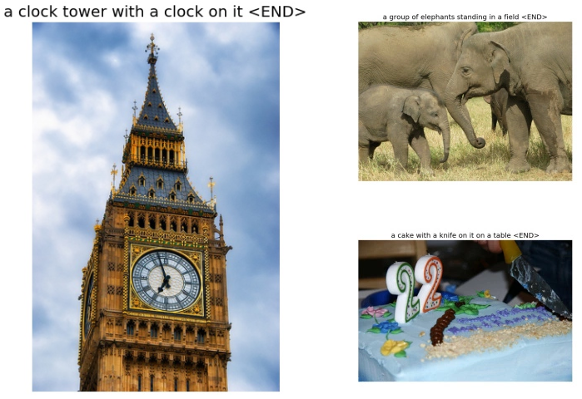
What is image caption?

Slide 3
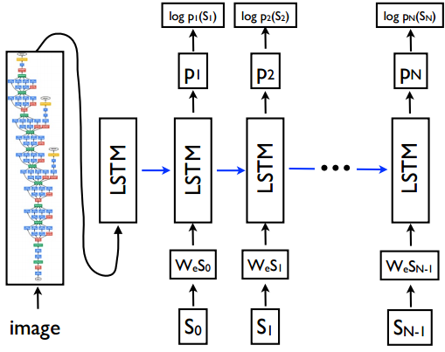
The model

Slide 4
The model – image part
Inception V3
Pool_3:0
2048 float
LSTM initial state
2048->512 float

Slide 5
The model – text part
Top 5000 + 4 words
One hot vector
2000 + 4 words (
Start, End, Null,
Unknown)
LSTM input
2004->512 float
LSTM output
2004 vector

Slide 6
The model – LSTM part
Fixed length vector
Default 25
LSTM parameter
512 hidden units

Slide 7
Coding part

Slide 8
The model – text part
embedding_map = tf.get_variable(name=“map”,shape=[config.vocab_size, config.embedding_size], initializer=some_initializer)
seq_embedding = tf.nn.embedding_lookup(embedding_map, input_seqs)

Slide 9
The model – image part (Part B)
image_embeddings = tf.contrib.layers.fully_connected(inputs=image_feature, num_outputs=config.embedding_size, activation_fn=None, weights_initializer=some_initializer, biases_initializer=None)

Slide 10
The model – LSTM initialization (Part A)
lstm_cell = tf.contrib.rnn.BasicLSTMCell(num_units=config.num_lstm_units, state_is_tuple=True)
lstm_cell = tf.contrib.rnn.DropoutWrapper(lstm_cell, input_keep_prob=keep_prob, output_keep_prob=keep_prob)

Slide 11
The model – LSTM predict (Part C)
_, initial_state = lstm_cell(image_embeddings, zero_state)
lstm_scope.reuse_variables()
# Run the batch of sequence embeddings through the LSTM.
sequence_length = tf.reduce_sum(input_mask, 1)
lstm_outputs, final_state = tf.nn.dynamic_rnn(cell=lstm_cell,
inputs=seq_embedding, sequence_length=sequence_length,
initial_state=initial_state, dtype=tf.float32, scope=lstm_scope)
lstm_outputs = tf.reshape(lstm_outputs, [-1, lstm_cell.output_size])

Slide 12
The model – LSTM predict (Part D)
W = tf.get_variable('W', [lstm_cell.output_size,
config.vocab_size], initializer=initializer)
b = tf.get_variable('b', [config.vocab_size],
initializer=tf.constant_initializer(0.0))
logits = tf.matmul(lstm_outputs, W) + b

